Slide 1
Active Clinical Drug Trial Database (ACT/DB)
Rohan Chouthai

Slide 2
Why Active Clinical Drug Trial Database
The ACT/DB is an important tool for-
Evidence based decision making
Getting clinical trial information.
This database will help -
Regulatory professionals
Medical practitioners
Clinical research investigators

Slide 3
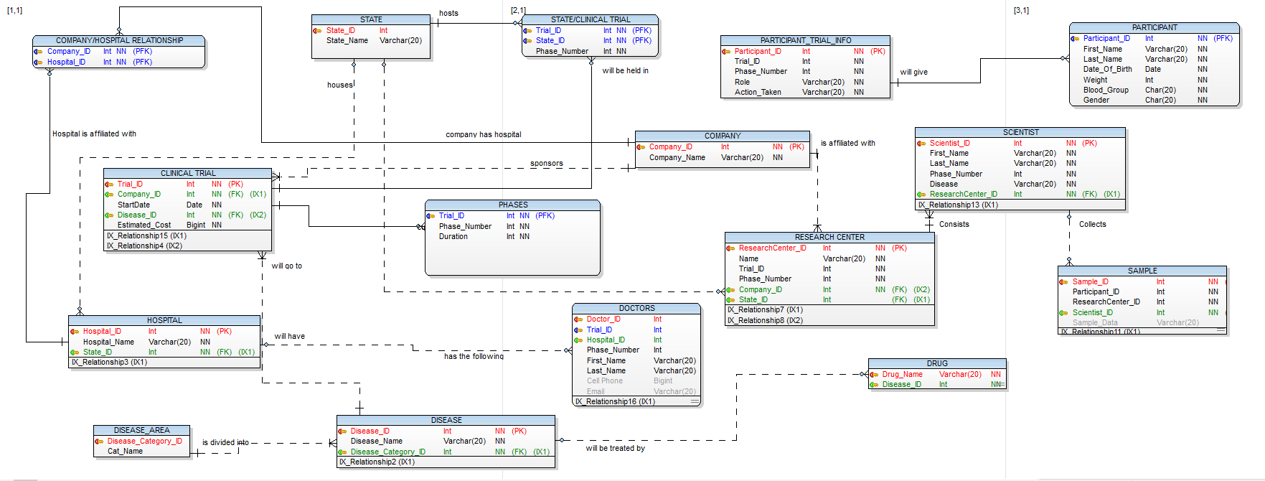
EER Diagram

Slide 4
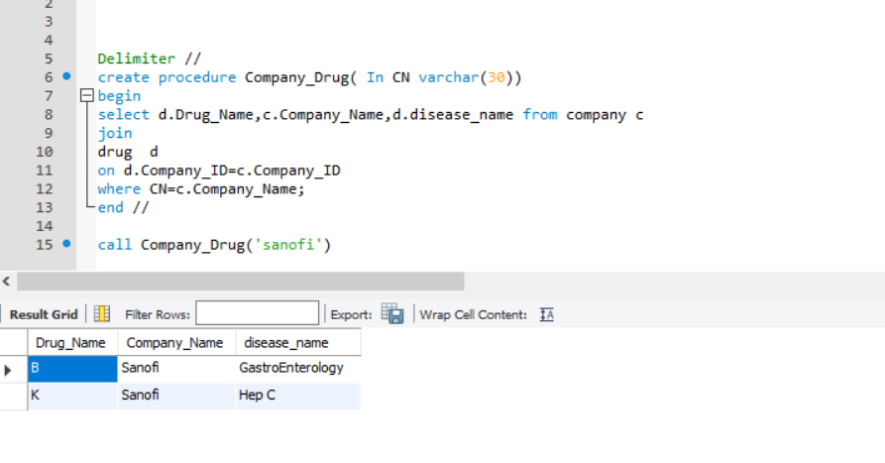
Stored Procedure 1- To Know Which Drug Is Produced By Which Company
This view will be generated by the following query:
Delimiter //
create procedure Company_Drug( In CN varchar(30))
Begin
select d.Drug_Name,c.Company_Name,d.disease_name
from company c join drug d
on d.Company_ID=c.Company_ID
where CN=c.Company_Name;
end //
call Company_Drug('sanofi')

Slide 5
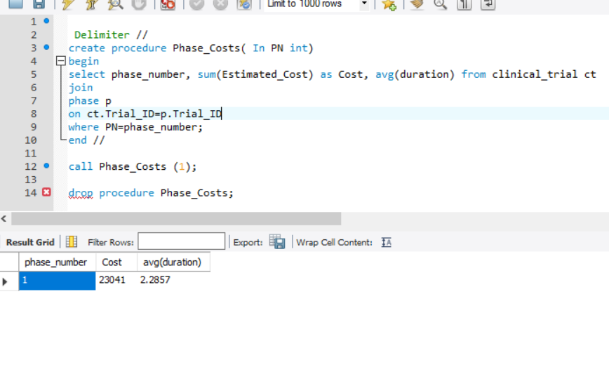
Stored Procedure 2- To Find The Cost And Average Duration For Any Phase
This view will be generated by the following query:
Delimiter //
create procedure Phase_Costs( In PN int)
begIn
select phase_number, sum(Estimated_Cost) as Cost, avg(duration)
from clinical_trial ct join phase p
on ct.Trial_ID=p.Trial_ID
where PN=phase_number;
end //

Slide 6
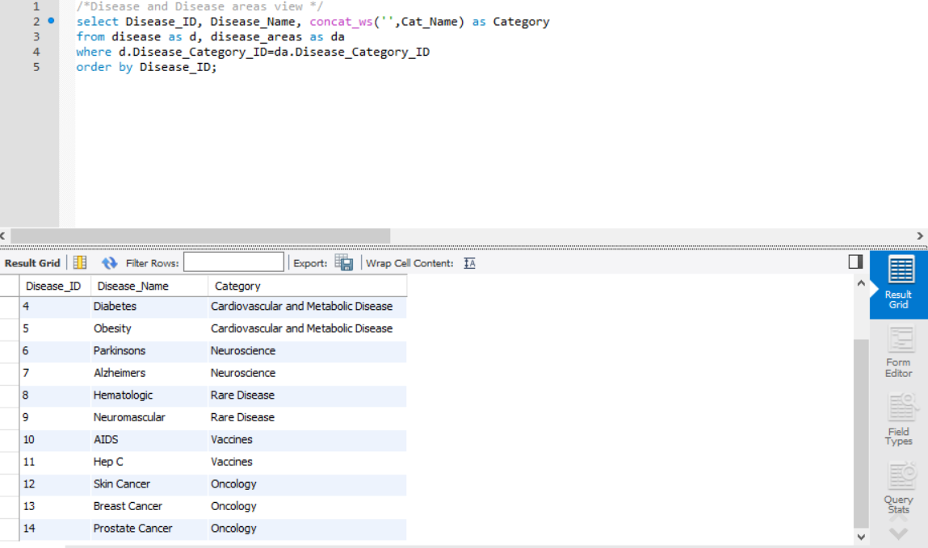
View 1- Disease and Disease Areas View
This view will be generated by the following query:
select Disease_ID, Disease_Name, concat_ws('',Cat_Name) as Category from disease as d, disease_areas as da
where d.Disease_Category_ID=da.Disease_Category_IDorder by Disease_ID;

Slide 7
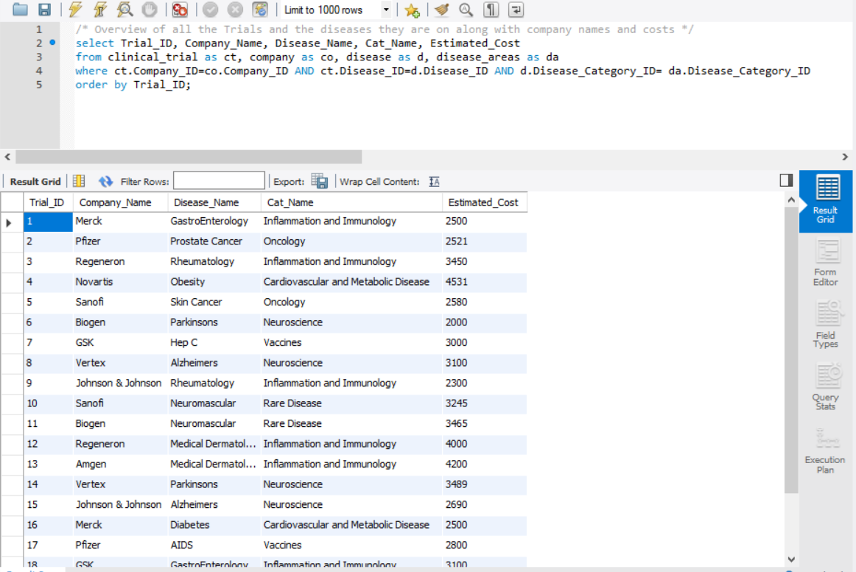
View 2- Overview Of All The Trials And Diseases
This view will be generated by the following query:
select Trial_ID, Company_Name, Disease_Name, Cat_Name, Estimated_Cost from clinical_trial as ct, company as co, disease as d, disease_areas as dawhere ct.Company_ID=co.Company_ID AND ct.Disease_ID=d.Disease_ID AND d.Disease_Category_ID= da.Disease_Category_IDorder by Trial_ID;

Slide 8
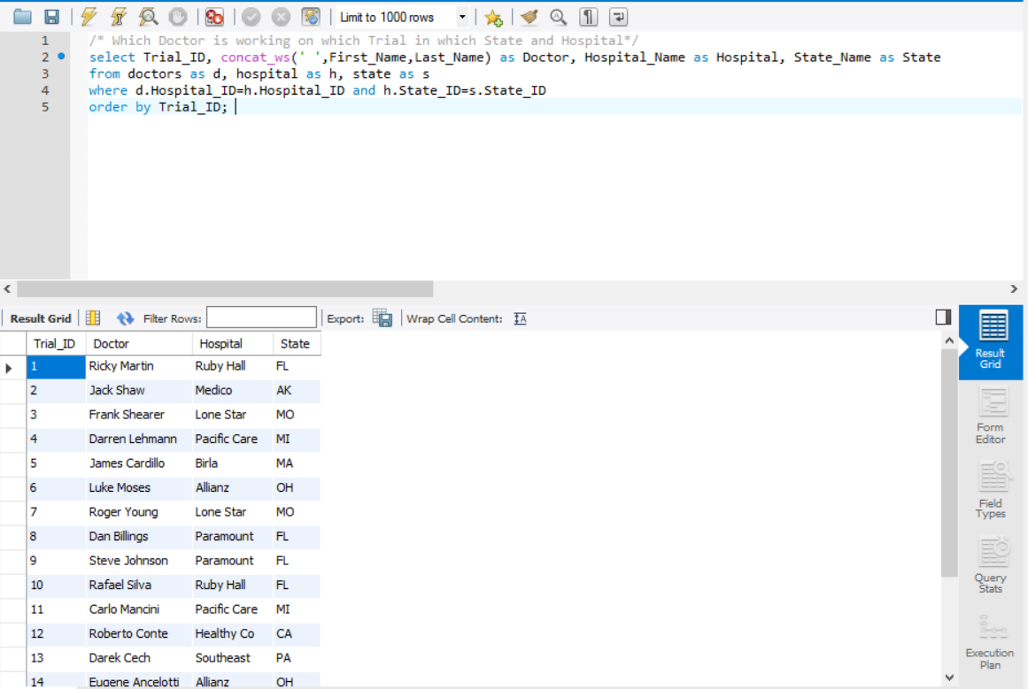
View 3- Detail Doctor Information
This view will be generated by the following query:
select Trial_ID, concat_ws(' ',First_Name,Last_Name) as Doctor, Hospital_Name as Hospital, State_Name as State
from doctors as d, hospital as h, state as s
where d.Hospital_ID=h.Hospital_ID and h.State_ID=s.State_ID
order by Trial_ID;

Slide 9
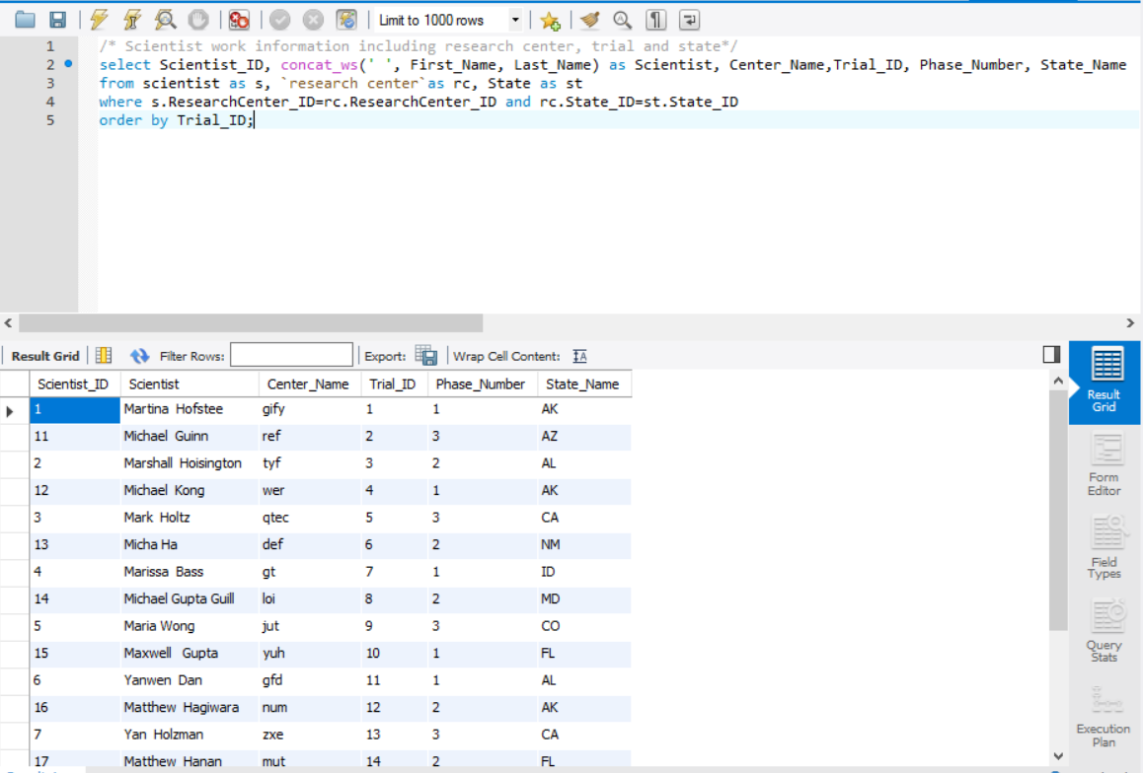
View 4- Scientist Research Information
This view will be generated by the following query:
select Scientist_ID, concat_ws(' ', First_Name, Last_Name) as Scientist, Center_Name,Trial_ID, Phase_Number, State_Name
from scientist as s, `research center`as rc, State as st
where s.ResearchCenter_ID=rc.ResearchCenter_ID and rc.State_ID=st.State_ID
order by Trial_ID;

Slide 10
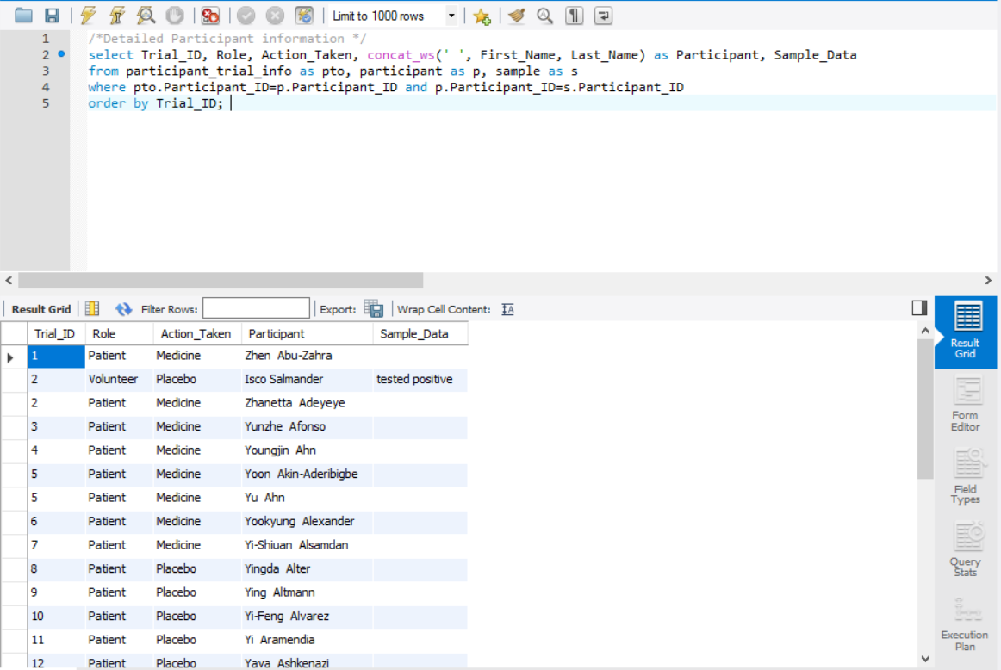
VIEW 5- Detail Participant Information
This view will be generated by the following query:
select Trial_ID, Role, Action_Taken, concat_ws(' ', First_Name, Last_Name) as Participant, Sample_Data
from participant_trial_info as pto, participant as p, sample as s
where pto.Participant_ID=p.Participant_ID and p.Participant_ID=s.Participant_ID
order by Trial_ID;

Slide 11
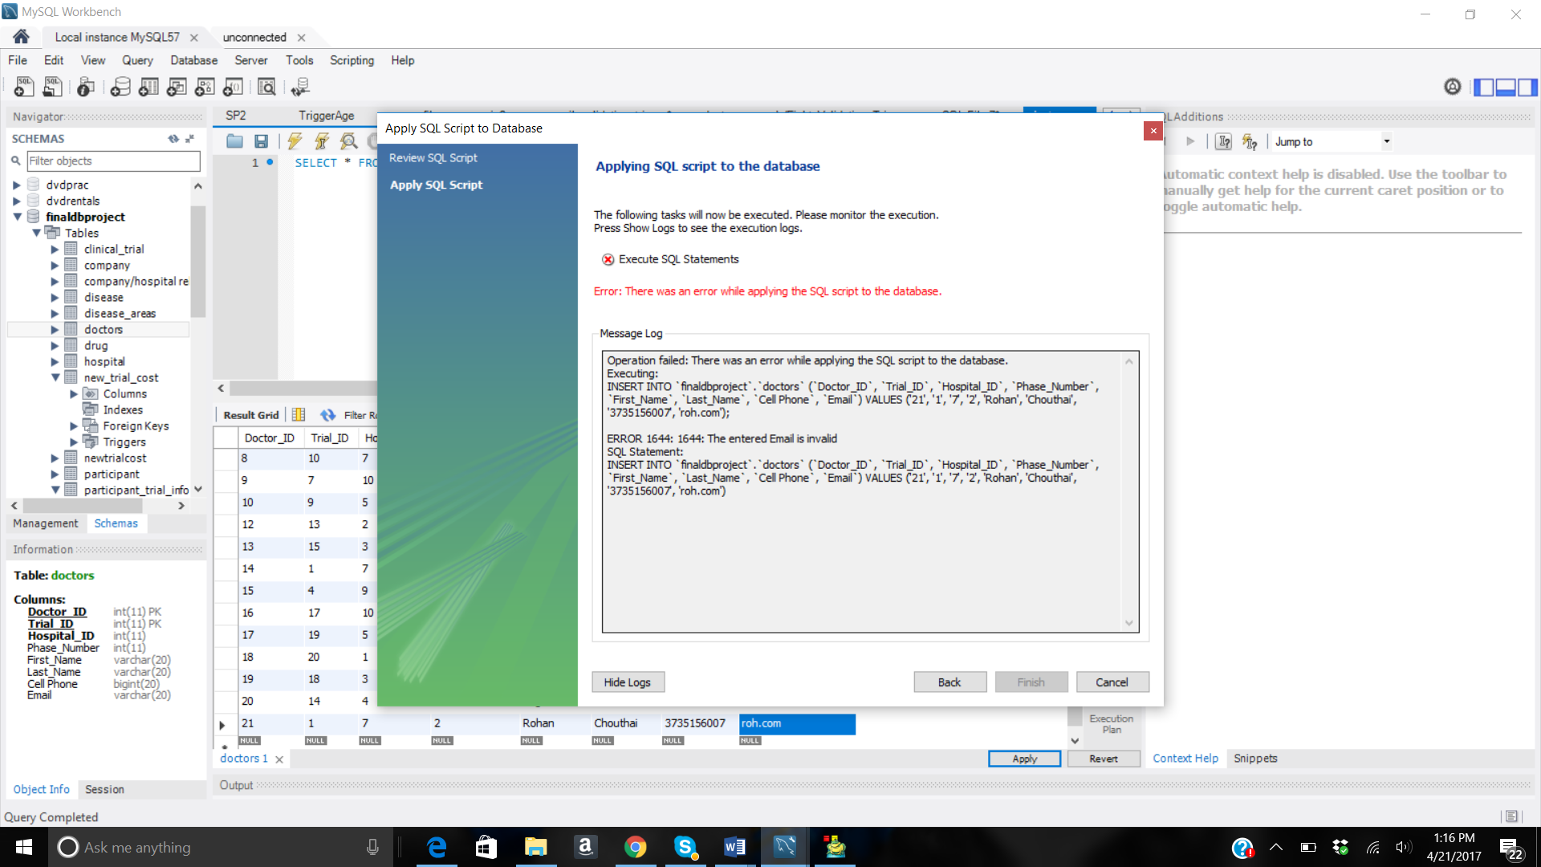
Trigger 1- Email_Validation
This view will be generated by the following query:
delimiter //
CREATE TRIGGER `email_validation` BEFORE INSERT ON `DOCTORS`
FOR EACH ROW
BEGIN
if new.Email not like '%_@%_._%' then
signal sqlstate value '45000'
set message_text ='The entered Email is invalid';
end if;
END;//

Slide 12
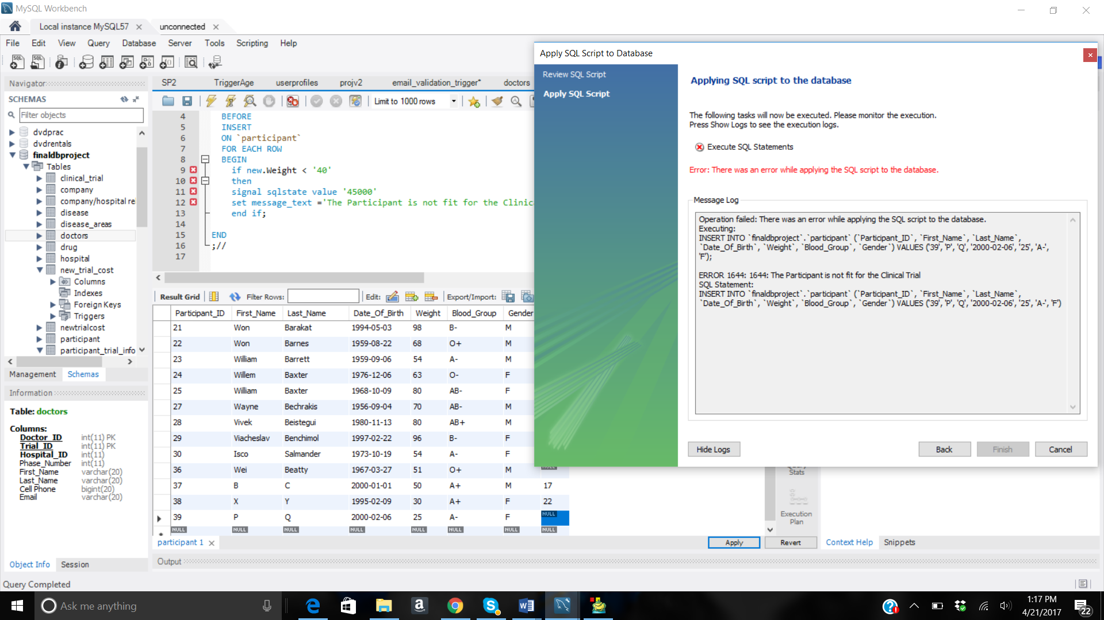
Trigger 2- Weight_Validation
This view will be generated by the following query:
delimiter //
CREATE TRIGGER `Weight_validation` BEFORE
INSERT ON `participant`
FOR EACH ROW
BEGIN
if new.Weight < '40'
then signal sqlstate value '45000'
set message_text ='The Participant is not fit for the Clinical Trial';
end if;
END;//

Slide 13
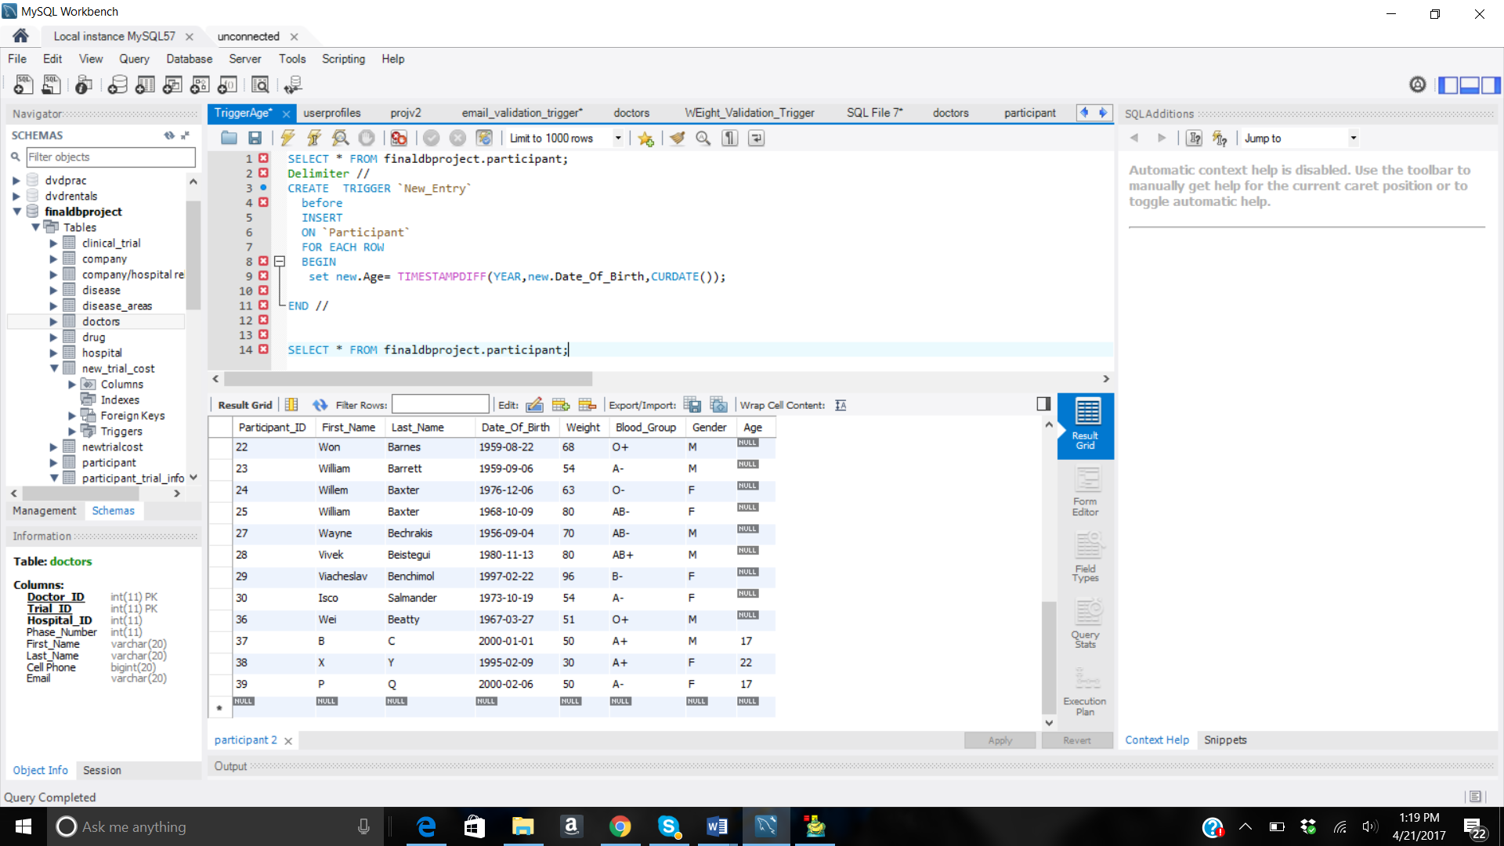
Trigger 3- Age_Update
This view will be generated by the following query:
Delimiter //
CREATE TRIGGER `New_Entry`
before
INSERT ON `Participant`
FOR EACH ROW
BEGIN
set new.Age= TIMESTAMPDIFF(YEAR,new.Date_Of_Birth,CURDATE());
END //

Slide 14
Key Takeaways From This Project
Normalization plays a very important role in designing the database
A database should be designed keeping the end user’s perspective in mind
An accurate and well defined data model yields a comprehensive and sound database

